Slide 1

Chapter 3
Cost Concepts and Behaviors
General Cost Terms
Classifying Costs for Financial Statements
Cost Classification for Predicating Cost Behaviors
Cost Concepts Relevant to Decision-Making
Thinking on the Margin: Fundamental Economic Decision-Making

Slide 2
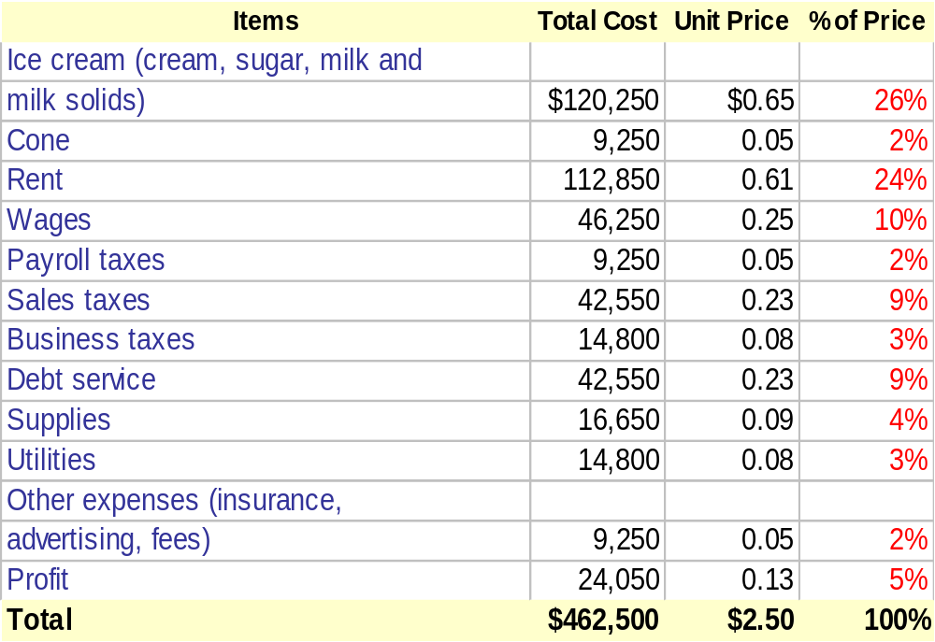
Unit Price of an Ice Cream Cone

Slide 3
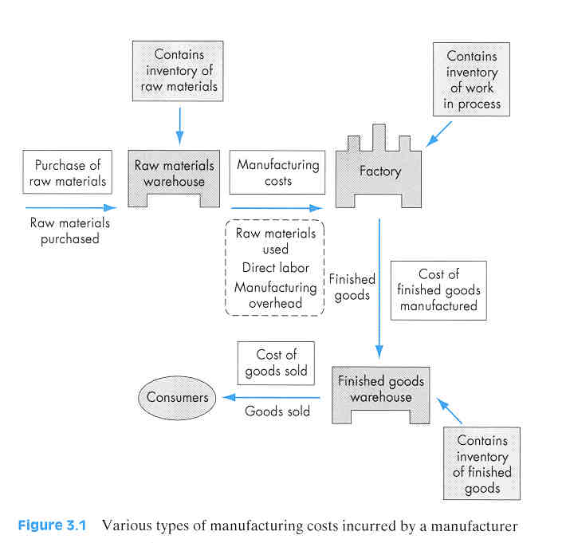
General Cost Terms
Manufacturing Costs
Direct materials
Direct labor
Mfg. Overhead
Non-manufacturing Costs
Overhead
Marketing
Administrative

Slide 4
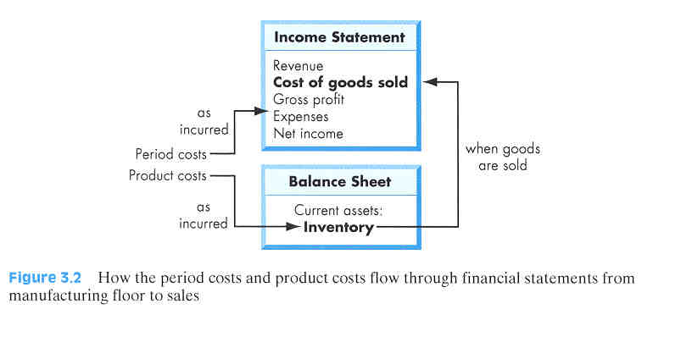
Classifying Costs for Financial Statements
Matching Concept: The costs incurred to generate particular revenue should be recognized as expenses in the same period that the revenue is recognized.
Period costs: Those costs that are matched against revenues on a time period basis
Product costs:Those costs that are matched against revenues on a product basis.

Slide 5
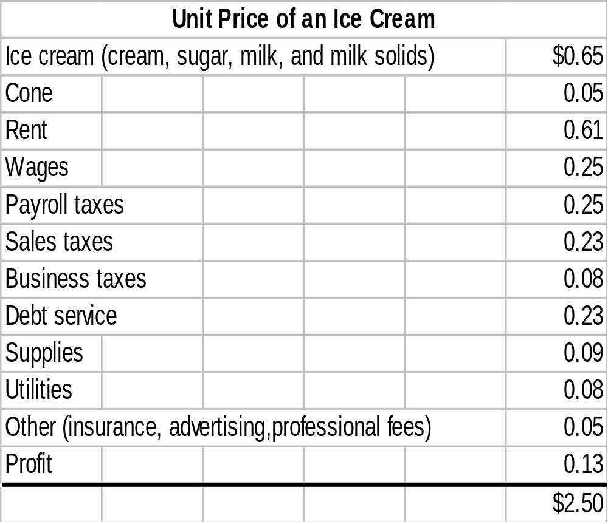
Classifying Costs for Uptown Ice Cream Shop
Product Cost
Period Cost

Slide 6
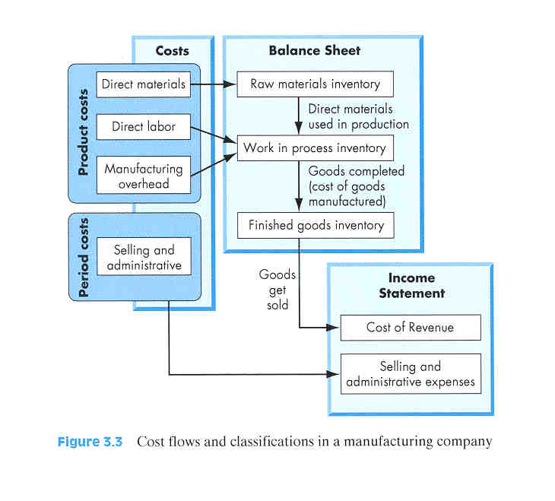
Cost Flows and Classifications in a Mfg. Co.
Cost of revenue = Cost of goods sold
Raw materials inventory
Work-in-process inventory
Finished goods inventory

Slide 7

Cost Classification for Predicting Cost Behavior
Volume index
Cost Behaviors
Fixed costs
Variable costs
Mixed costs
Average unit costs

Slide 8

Volume Index
Def: The unit measure used to define “volume”
Examples:
  Automobile – “miles” driven
  Generating plant – “kWh” produced
  Stamping machine – “parts” stamped

Slide 9
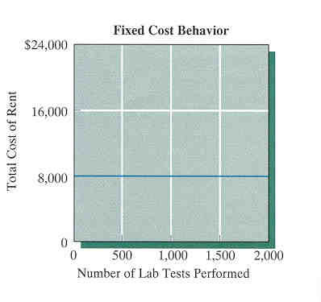
Fixed Costs
Def: The costs of providing a company’s basic operating capacity
Cost behavior: Remain constant over the relevant range

Slide 10
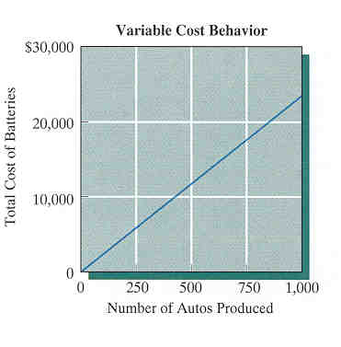
Variable Costs
Def: Costs that vary depending on the level of production or sales
Cost behavior: Increase or decrease proportionally according to the level of volume

Slide 11

Average Unit Cost
Def: activity cost per unit basis
Cost Behaviors:
  Fixed cost per unit varies with changes in volume.
  Variable cost per unit of volume is a constant.

Slide 12
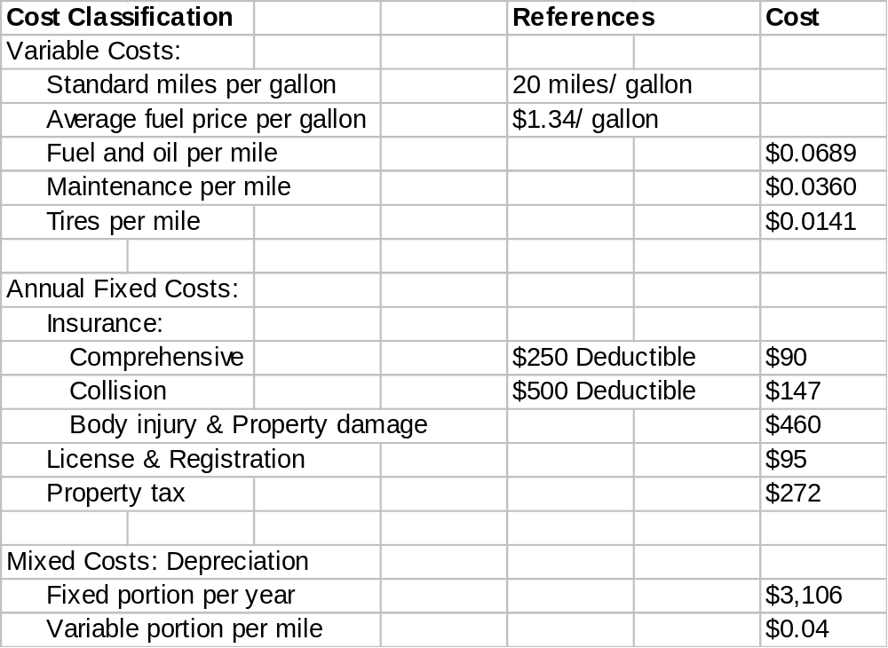
Cost Classification of Owning and Operating a Passenger Car

Slide 13
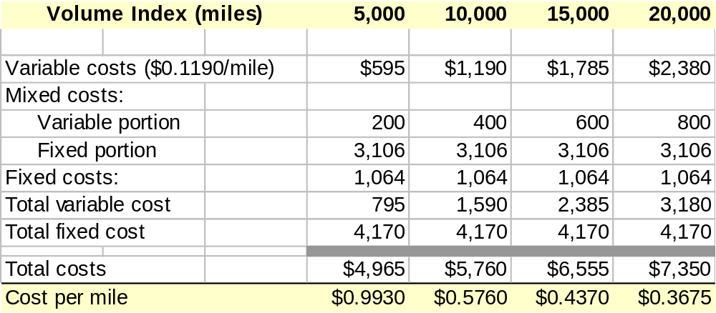
Cost-Volume Relationship

Slide 14
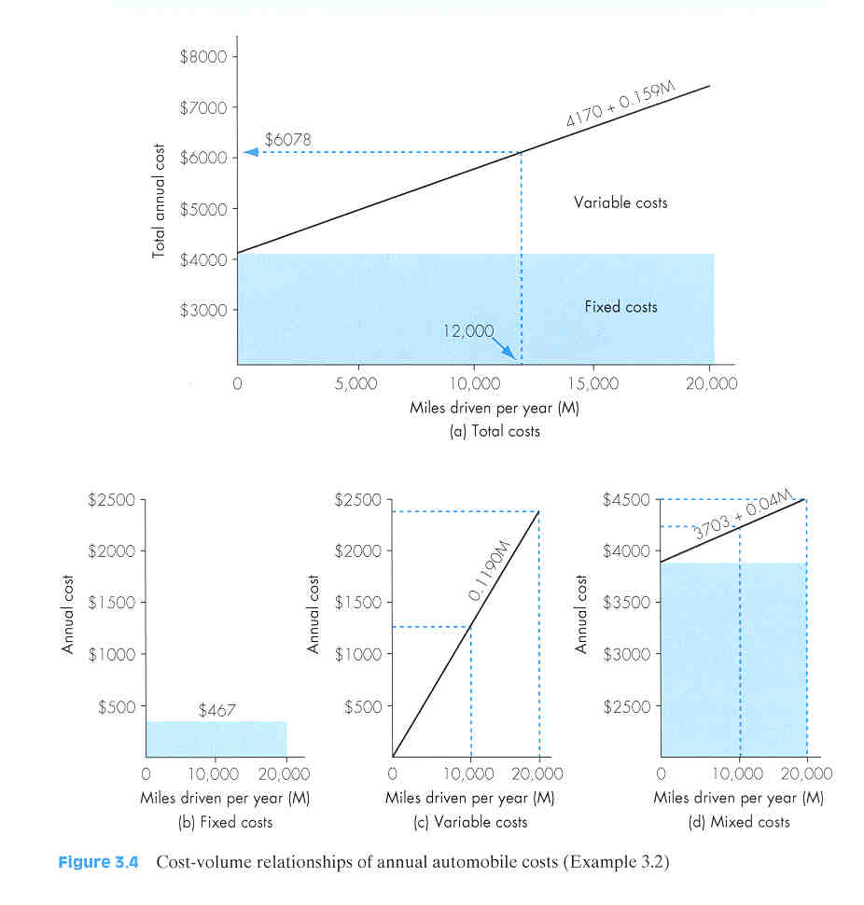
Cost-Volume Relationship

Slide 15
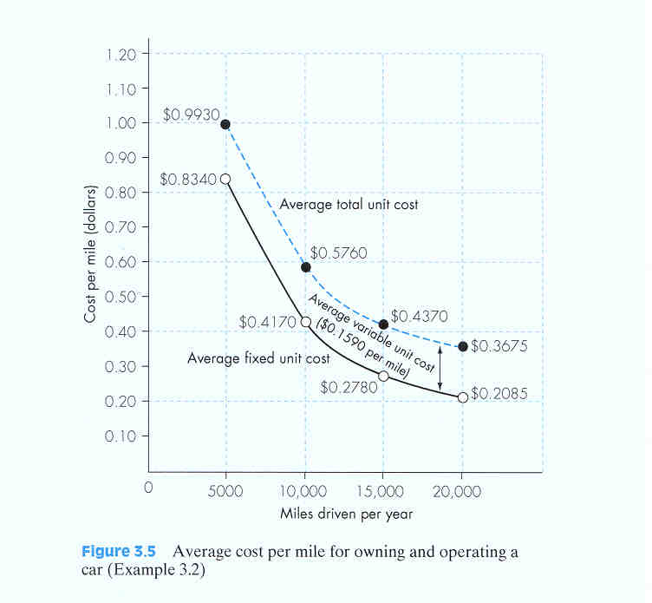
Average Cost per Mile

Slide 16

Differential (Incremental) Costs
Def: Costs that represent the differences in total costs, which results from selecting one alternative instead of other

Slide 17
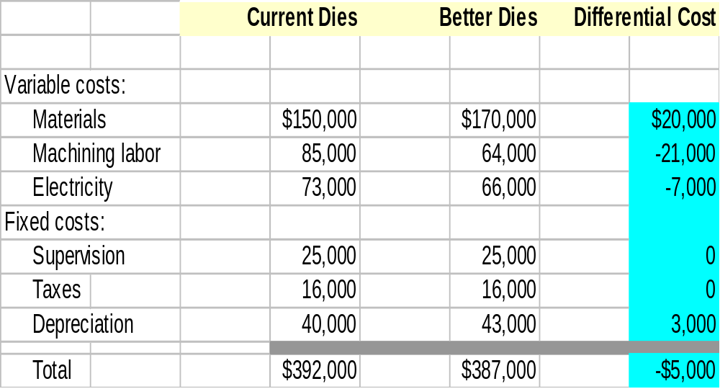
Example 3.3: Differential Cost Associated with Adopting a New Production Method

Slide 18
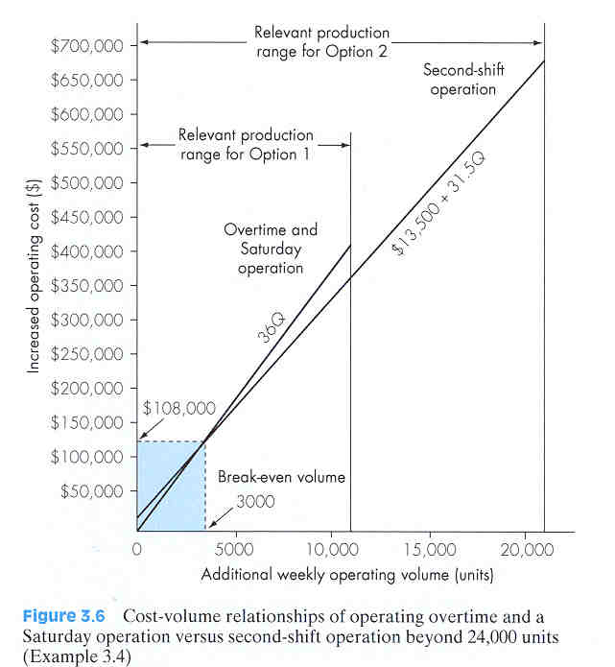
Example 3.4 Break-Even Volume Analysis
Option 1: Adding overtime or Saturday operations: 36Q
Option 2: Second-shift operation: $13,500 + 31.50Q
Break-even volume:
36Q = $13,500 + 31.50Q
Q = 3,000 units

Slide 19
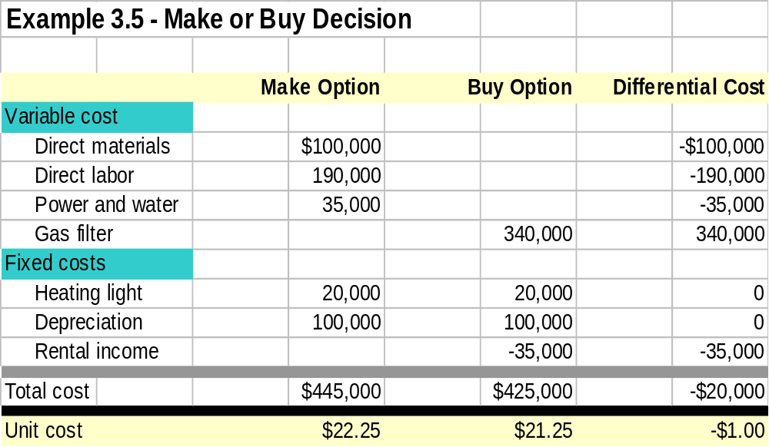
Example 3.5 -Make or Buy

Slide 20

Opportunity Costs
Def: The potential benefit that is given up as you seek an alternative course of action
Example: When you decide to pursue a college degree, your opportunity cost would include the 4-year’s potential earnings foregone.

Slide 21

Sunk Costs
Def:Cost that has already been incurred by past actions
Economic Implications: Not relevant to future decisions
Example: $500 spent to replace tires last year—not relevant in making selling decision in the future

Slide 22
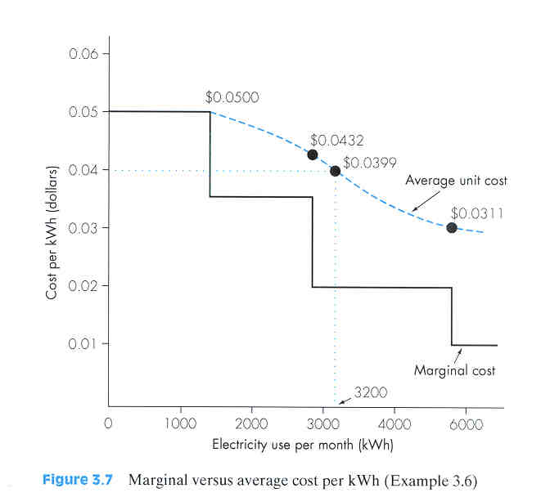
Marginal Costs
Def: Added costs that result from increasing rates of outputs, usually by single unit
Example: Cost of electricity—decreasing marginal rate

Slide 23

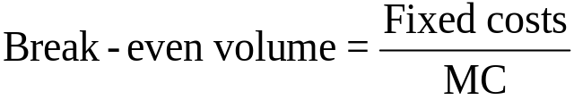
Unit Marginal Contribution
Def: Difference between the unit sales price and the unit variable cost
MC = Sales price – Variable cost
Application: Break-even volume analysis:

Slide 24
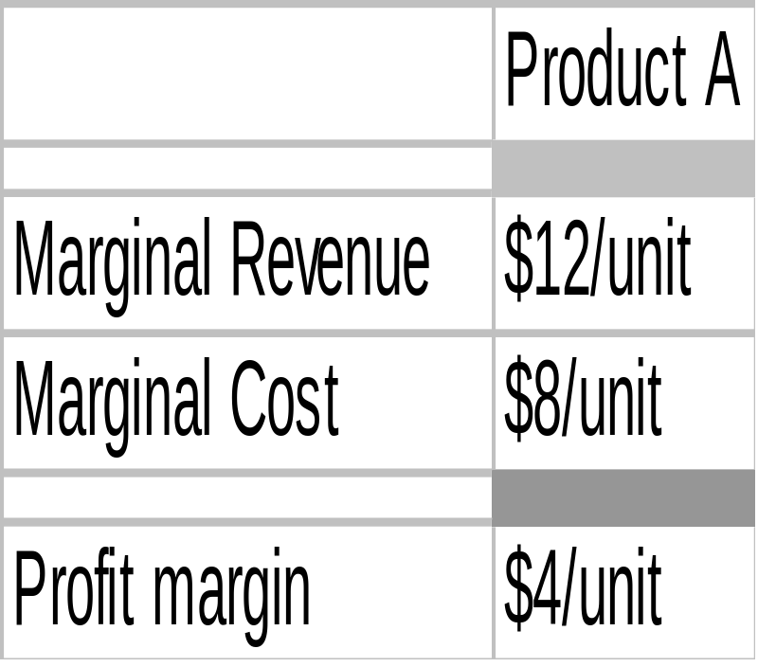
Marginal Analysis
Principle: “Is it worthwhile?”
Decision rule: To justify any course of action,
Marginal revenue >
Marginal cost

Slide 25
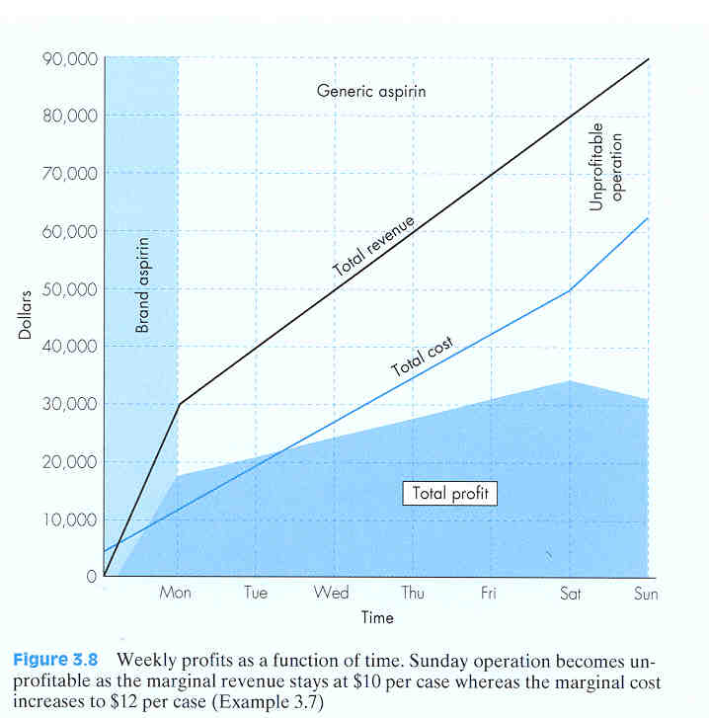
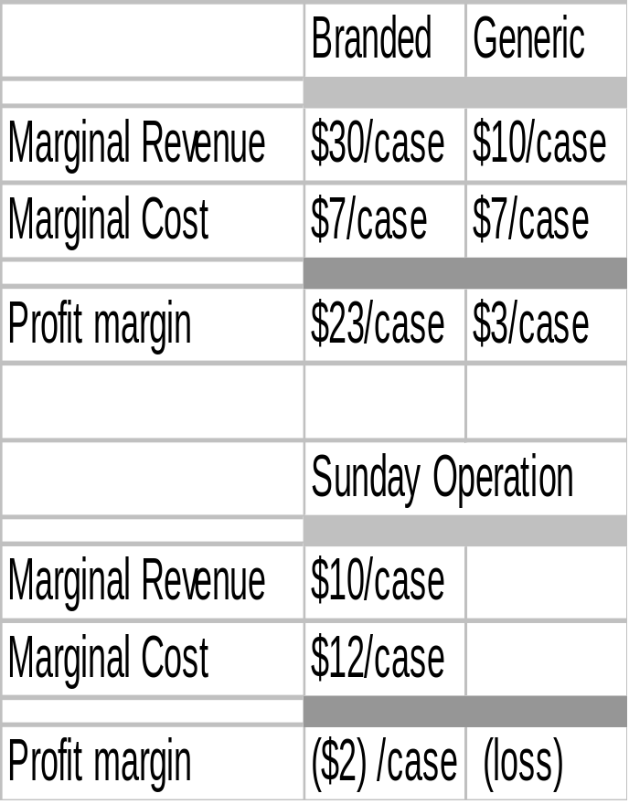
Example 3.7 Profit Maximization Problem

Slide 26
Summary
General Cost Terms used in manufacturing:
  Manufacturing costs
    Direct materials
    Direct labor
    Manufacturing overhead
  Nonmanufacturing costs
    Administrative expenses
    Marketing
    Nonmanufacturing overhead

Slide 27
Classifying Costs for Financial Statements:
  Period costs
  Product costs
Cost Classification for Predicating Cost Behaviors:
  Fixed costs
  Variable costs
  Mixed costs

Slide 28
Cost Concepts Relevant to Decision-Making
  Differential cost and revenue
  Opportunity costs
  Sunk costs
  Marginal costs
Thinking on the Margin: Fundamental Economic Decision-Making:
  The basic question to any economic decision: Is it worthwhile?
  Marginal revenues must exceed marginal costs.

